Slide 1
DSD - ASVS
Google Big query

Slide 2
Agenda
Overall Architecture
Observations and Findings
Questions

Slide 3

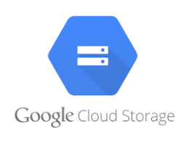

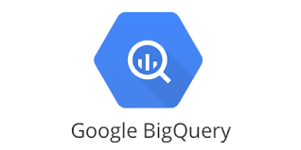
Overall Architecture – Google Cloud Platform
Kaggle Data Repository
Google Cloud Storage [Data Storage]
Google Data Studio
(Data Visualization)
Google Big Query
(Data Processing)

Slide 4
Observations and Findings
We have chosen Home Credit Default Risk dataset from Kaggle which contains 2.68 GB of Data
https://www.kaggle.com/c/home-credit-default-risk/data
GCP offers free 300$ credit for 90 days

Slide 5
Implementations
BigQuery basically being an end point query engine, we’ll be processing heavy memory and process intense queries.
Queries will be involving window functions on large data sets, multiple simple joins and complex joins including cross join and utilizations of Group by clauses.
Comparisons will be performed on Distributed system cloud service (GCP), postgresql and Oracle single system architecture.

Slide 6
Questions
What exactly we need to implement in GCP using distributed systems.

